Slide 1
Minimum Spanning Trees

Slide 2
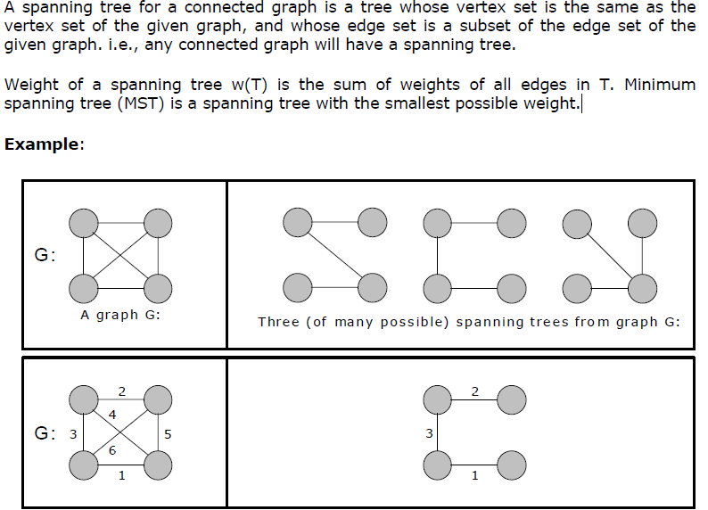

Slide 3
Minimum spanning tree, can be constructed using any of the following two algorithms:
1. Kruskal’s algorithm and
2. Prim’s algorithm.
Kruskal's algorithm uses edges, and Prim’s algorithm uses vertex connections in determining the MST.
In Prim’s algorithm at any instance of output it represents tree whereas in Kruskal’s algorithm at any instance of output it may represent tree or not
Applications:
MST would be used in finding airline routes
MST would be used in finding distances on maps and to find best route between two places.
MST would be used in networking to find best path to transfer information.
MST would be used in traffic recommendations , to suggest best route.

Slide 4
PRIM'S ALGORITHM
Minimal cost spanning tree is a connected undirected graph G in which each edge is labeled with a number.
Minimal cost spanning tree is a spanning tree for which the sum of the edge labels is as small as possible
E is the set of edges in G. cost [1:n, 1:n] is the cost adjacency matrix of an n vertex graph such that cost [i, j] is either a positive real number or ∝ if no edge (i, j) exists.
A minimum spanning tree is computed and stored as a set of edges in the array t [1:n-1, 1:2].
(t [i, 1], t [i, 2]) is an edge in the minimum-cost spanning tree.
The final cost is returned.

Slide 5
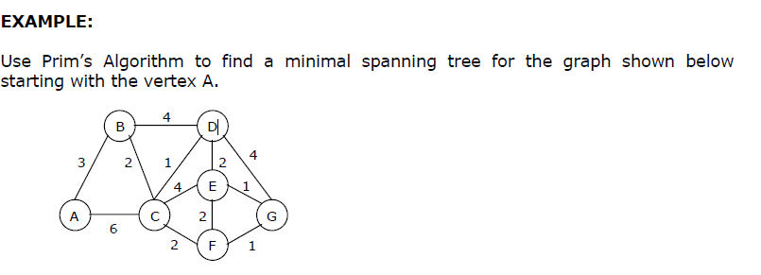
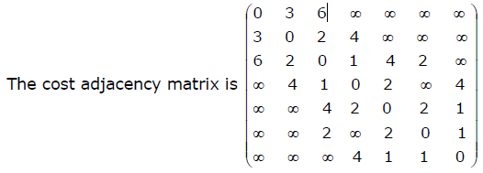

Slide 6
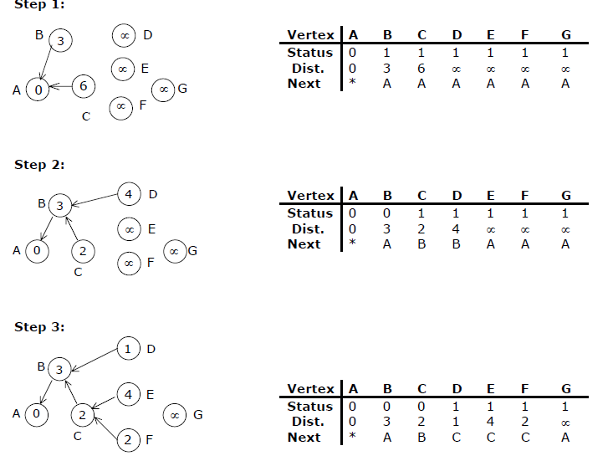

Slide 7
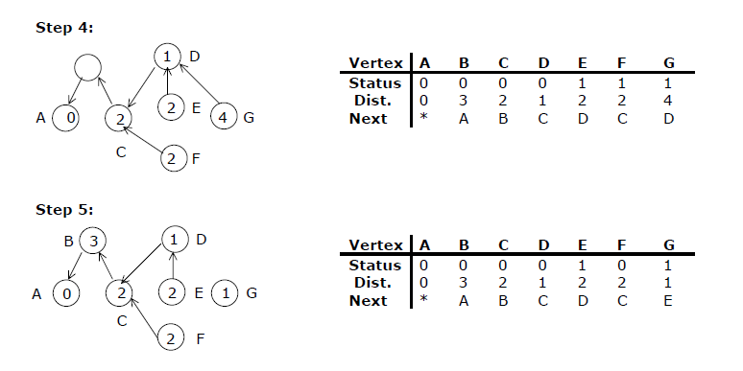

Slide 8
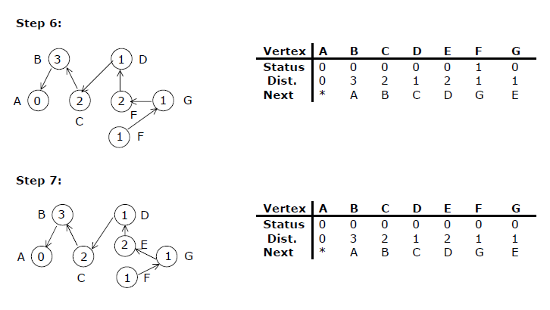
o/p: A,B,C,D,E,G,F. Total Cost: 10

Slide 9
int minKey(int key[], bool mstSet[])
{
// Initialize min value
int min = INT_MAX, min_index;
for (int v = 0; v < V; v++)
if (mstSet[v] == false && key[v] < min)
min = key[v], min_index = v;
return min_index;
}
void printMST(int parent[], int graph[V][V])
{
for (int i = 1; i < V; i++)
printf(“%d - %d \n”,parent[i],graph[i][parent[i]]);
}
PRIMS Algorithm:
void primMST(int graph[V][V])
{
int parent[V];
int key[V];
bool mstSet[V],u;
for (int i = 0; i < V; i++)
key[i] = INT_MAX, mstSet[i] = false;
key[0] = 0;
parent[0] = -1;
for (int count = 0; count < V - 1; count++)
{
u = minKey(key, mstSet);
mstSet[u] = true;
for (int v = 0; v < V; v++)
if (graph[u][v] && mstSet[v] == false && graph[u][v] < key[v])
parent[v] = u, key[v] = graph[u][v];
}
printMST(parent, graph);
}

Slide 10
Kruskal’s Algorithm
This is a greedy algorithm. A greedy algorithm chooses some local optimum (i.e. picking an edge with the least weight in a MST).
Kruskal's algorithm works as follows: Take a graph with 'n' vertices, keep on adding the shortest (least cost) edge, while avoiding the creation of cycles, until (n - 1) edges have been added. Sometimes two or more edges may have the same cost.
The order in which the edges are chosen, in this case, does not matter. Different MST’s may result, but they will all have the same total cost, which will always be the minimum cost.

Slide 11
Kruskal’s Algorithm for minimal spanning tree is as follows:
Make the tree T empty.
Repeat the steps 3, 4 and 5 as long as T contains less than n - 1 edges and E is not empty otherwise, proceed to step 6.
Choose an edge (v, w) from E of lowest cost.
Delete (v, w) from E.
If (v, w) does not create a cycle in T then Add (v, w) to T else discard (v, w)
6. If T contains fewer than n - 1 edges then print no spanning tree.

Slide 12
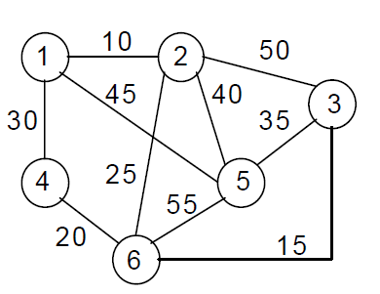
Cost | 10 | 15 | 20 | 25 | 30 | 35 | 40 | 45 | 50 | 55
Edge | (1, 2) | (3, 6) | (4, 6) | (2, 6) | (1, 4) | (3, 5) | (2, 5) | (1, 5) | (2, 3) | (5, 6)

Slide 13
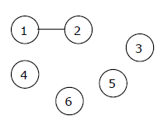
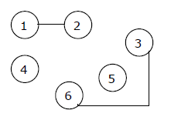
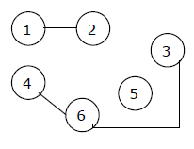
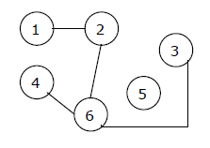
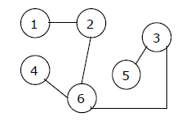

10
10
10
15
15
20
10
10
35
25
25
15
15
20
20
Cost | 10 | 15 | 20 | 25 | 30 | 35 | 40 | 45 | 50 | 55
Edge | (1, 2) | (3, 6) | (4, 6) | (2, 6) | (1, 4) | (3, 5) | (2, 5) | (1, 5) | (2, 3) | (5, 6)

Slide 14
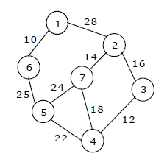
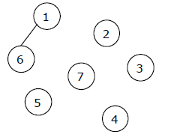
Edge | Weight

